Slide 1
Strategy Pattern
Behavioral, Object focused

Slide 2
Example on hand(Age of empires)
Soldier class(Main class)
subclass: spearman,archar, gunman, paladin, robot, ironman
Refill and repair functionality, different in different class
Refill: when empty(archar) or certain time(gunman), no-refill
Repair: internal(ironman) or external(robot), no-repair
Strategy

Slide 3
Example on hand(Age of empires)
Soldier class(Main class)
subclass: spearman,archar, gunman, paladin, robot, ironman
Refill and repair functionality, different in different class
Refill: when empty(archar) or certain time(gunman), no-refill
Repair: internal(ironman) or external(robot), no-repair
Strategy
Inheritance- problem some class don’t need functionality
Interface - code reuse- duplication
strategy pattern - Always program in super type
a family of algorithms
encapsulates their behaviour
Makes the algorithm interchangeable with that family

Slide 4
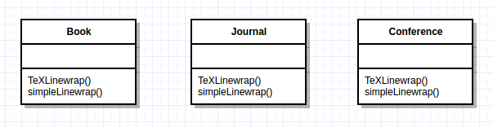
Motivation
Many possible algorithms exist to solve every problem
Hard-wiring each algorithm into each instance becomes intractable
For example, line wrapping in different documents can use the same algorithms
Different algorithms may be appropriate in different situations
Difficult to integrate new algorithms if code is hard-wired

Slide 5
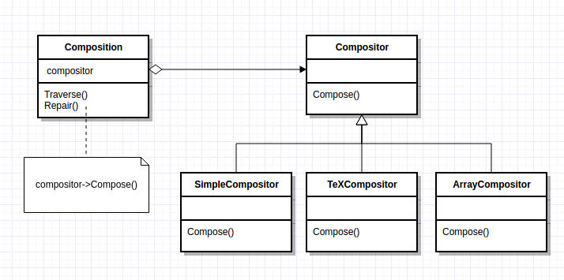
Motivation
Define classes that encapsulate different algorithms (e.g. linebreaking)
An algorithm encapsulated this way is called a strategy

Slide 6
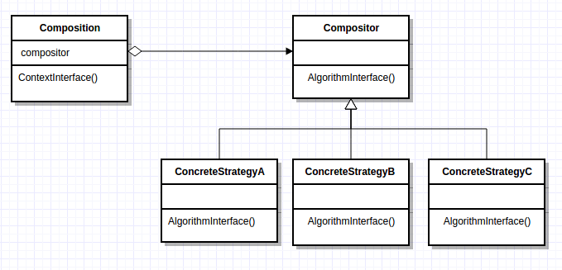
Structure (Example: cpp.sh/4ssjc)
Strategy (compositor)
Declares common interface for all supported algorithms
Concrete Strategy
Implements the algorithms using the strategy interface
Context (composition)
Configured with a concrete strategy object
Maintains reference to strategy object
May define interface to allow strategy to access its data

Slide 7
Consequences
Pros:
Families of related algorithms
Inheritance factors out common functionality of algorithms
Alternative to subclassing
Allows varying the algorithm independently from the context
Strategies eliminate conditional statements
Offers different implementation of the same behavior
Cons:
Incurs communication overhead between algorithm and context
Increases the number of objects

Slide 8
Self study
Example from “Design Patterns: Elements of Reusable Object-Oriented Software”
Erich Gamma
Richard Helm
Ralph Johnson
John Vlissides

Slide 9
Formatting
Definition: Breaking a collection of glyphs into lines, lines into columns, and columns onto pages.
Many, many complex methods (algorithms) exist for formatting
We want to keep them self contained and independent of the document structure
Adding a new Glyph should not affect the code (black-box reuse)
This is done by ISOLATING and ENCAPSULATING the algorithm in an object

Slide 10
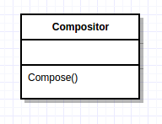
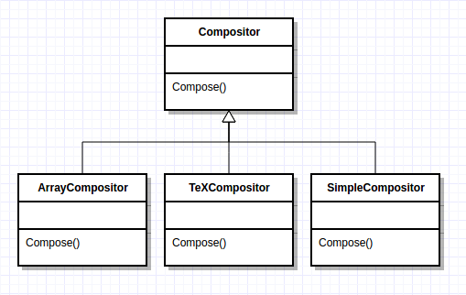
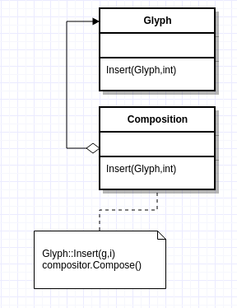
Formatting
Let’s define a separate class hierarchy for formatting algorithms
The root (compositor) will define the interface
Subclasses implement a specific algorithm
A Glyph subclass can structure its children for the given algorithm object

Slide 11
Compositor and Composition
The Compositor class encapsulates the formatting algorithm
The interface lets the compositor know what glyphs to format and when to do the formatting
The glyphs formatted are children of the special Composition glyph subclass

Slide 12
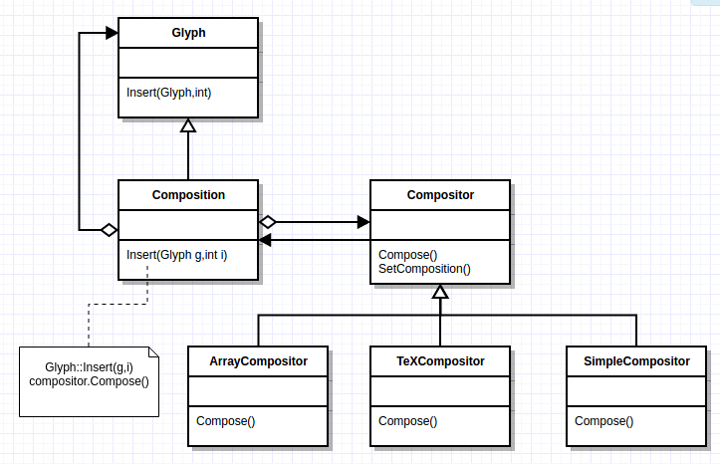
Basic Compositor Interface
Responsibility | Operations
What to format | void SetComposition(Composition*)
How to format | virtual void Compose()

Slide 13
How to use the Composition and Compositor
A Composition gets an instance of a Compositor subclass
The compositor subclass implements a specific formatting algorithm
An unformatted Composition object contains only visible glyphs making up the document’s content
Glyphs determining the physical structure (Row and Column) are not contained
To format, the Composition calls compositor.Compose()
The Compositor iterates through the Compositions children and inserts new Row and Column glyphs according to the Compositor algorithm

Slide 14
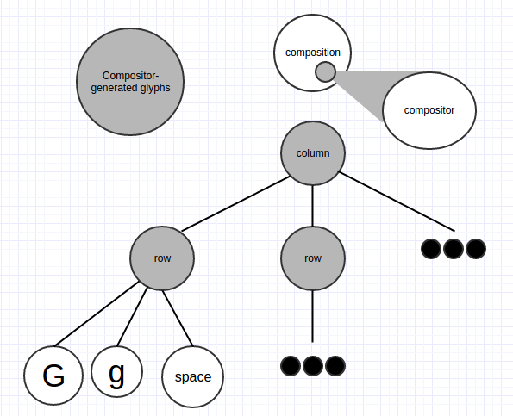
How to use the Composition and Compositor
The Compositor iterates through the Compositions children and inserts new Row and Column glyphs according to the Compositor algorithm

Slide 15
Benefits
The Compositor-Composition class split ensures a separation between code for the physical structure, and formatting algorithm code
Adding a new Compositor subclass does not affect the glyph classes
Adding a new Glyph subclass does not affect the Compositor classes
Using dynamic binding, the line-breaking algorithm can be changed at run-time through the SetCompositor() operation

Slide 16
Strategy Pattern Review
Encapsulating an algorithm in an object is the intent of the Strategy Pattern
The key participants in the pattern are Strategy objects (compositor) and the context in which they operate (composition)
The key to applying the Strategy pattern is designing interfaces for the strategy and its context that are general enough to support a range of algorithms
Follow the Three Strikes and Refactor rule

